Slide 1
SMK project
Questions - MD

Slide 2
Questions
Can the variableStart cells have two variables shown in brackets (see the example below)?
Should the small population provinces be grouped together (NWT+YK+NV)?
Can I add the OncoSim convention for provinces (NWT+NV)? Doug says we can add new vars!
For example: SMK_203, SMK_207, SMK_09C are continuous in the master cycles. The CCHS flow pkg uses the derived categorical vars to reconstruct a continuous version. Can we just keep the continuous type variables and avoid using the categorical (derived) vars for now? Doug says we can. So we will use the original continuous vars.
Can we add the 2022 & 2023 cycles to SMKDSTY_B? (see slides 3 and 4)
Can we learn more about the selection of SMK_100 in SMK_06A? (see slides 5-8)
Are we interested in adding the cycle 2022 to SMK_09A_cont? (see slide 9)

Slide 3
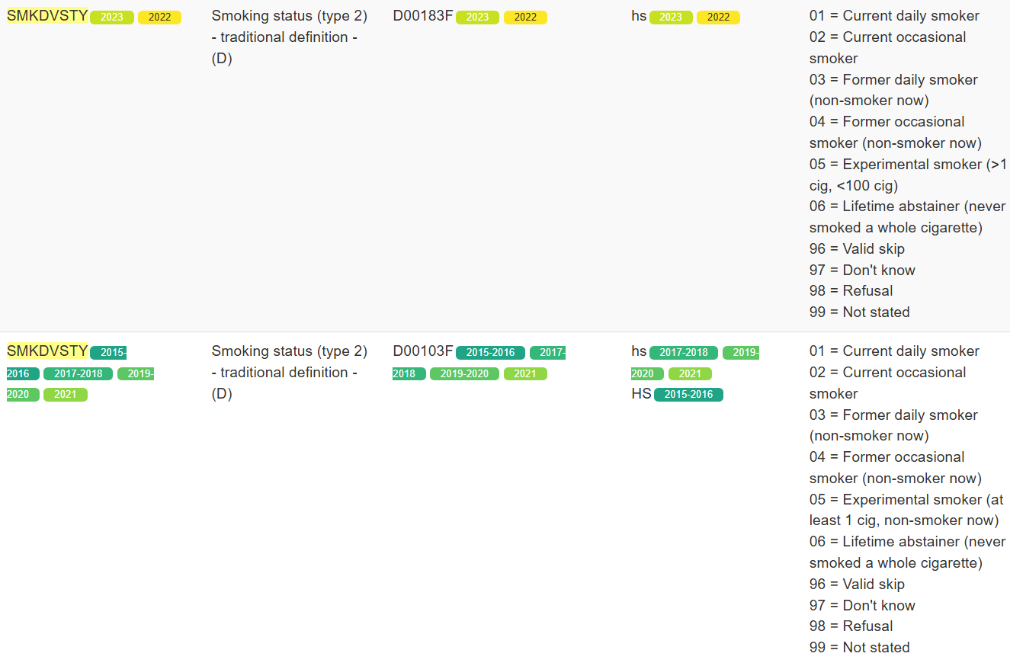

SMKDSTY_B
Can we include 2022 & 2023?
These cycles are not included in the xlsx file

Slide 4
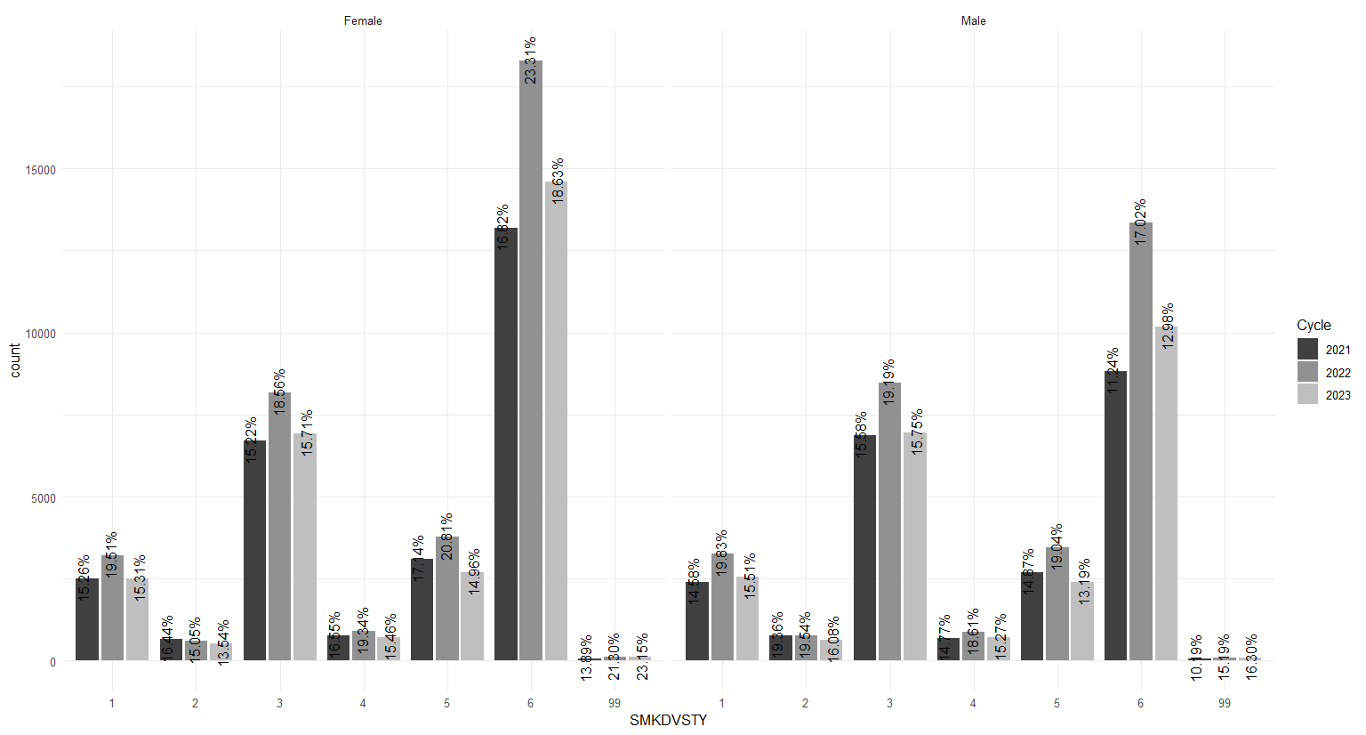
SMKDSTY_B
Doug says that he would like to see the histograms: I just added the last three cycles

Slide 5
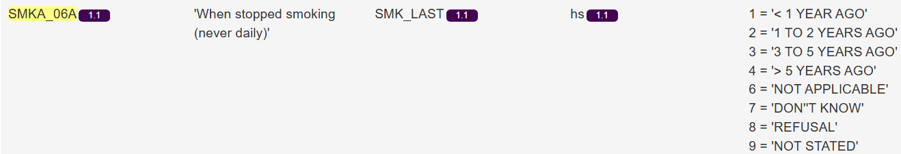
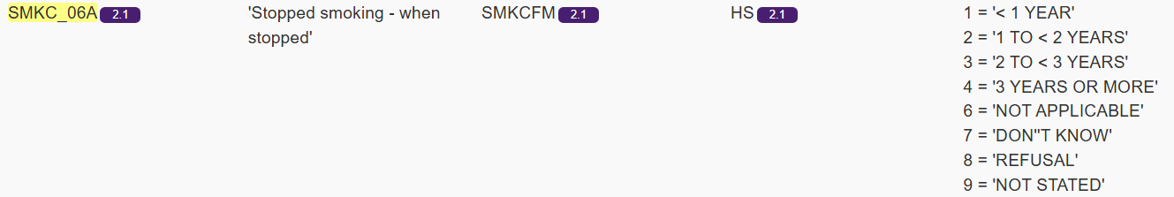
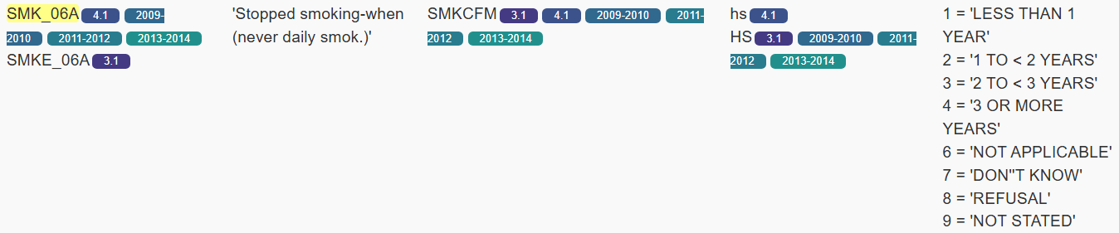
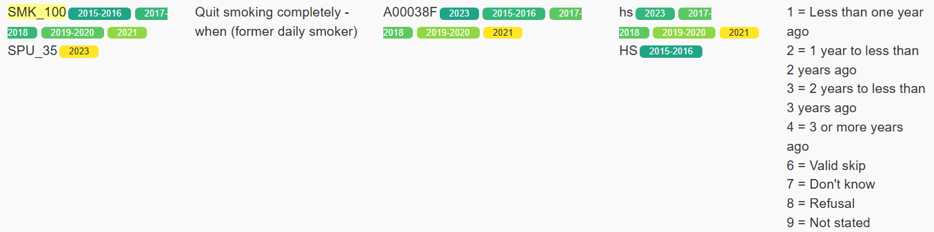
SMK_06A (version A, B, and continuous)
I'm interested in learning more about the selection of SMK_100. I'm curious about the decision flow. Can you share it with me? I'd like to understand the flags or filters that are involved.

Slide 6
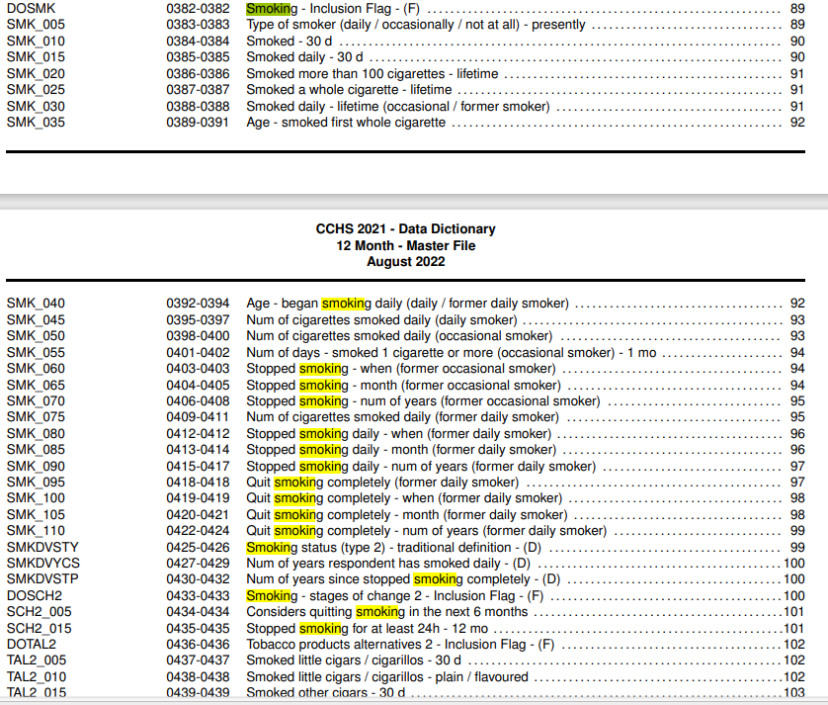
SMK_06A

Slide 7
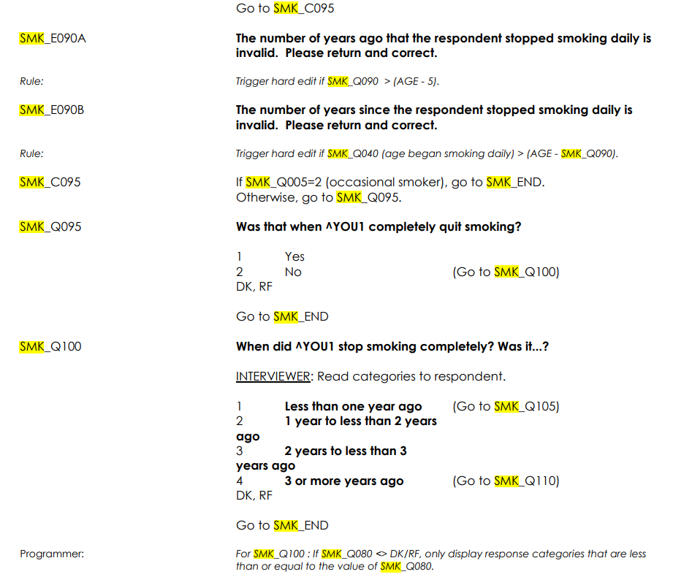
SMK_06A

Slide 8
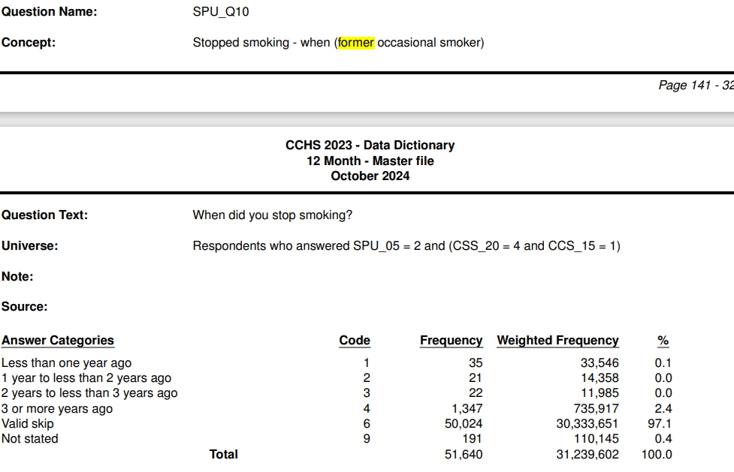
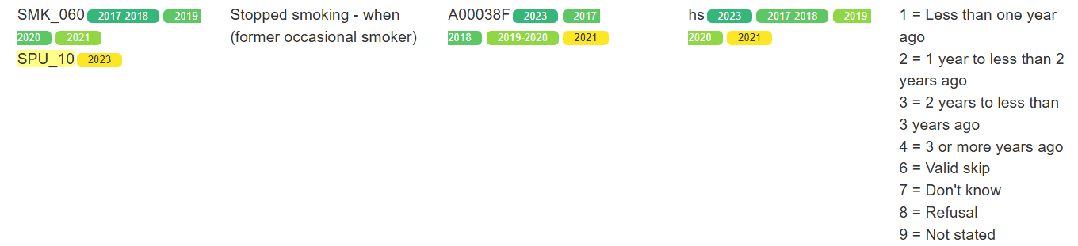
SMK_06A
It seems like a better option, but I'm not sure how the decision-making process works.
Notes:
SPU_10 : Stopped smoking - when (former occasional smoker)
Universe: Respondents who answered SPU_05 = 2 and (CSS_20 = 4 and CCS_15 = 1)
SPU_05: Smoked daily - lifetime (occasional / former smoker) ==No [2]
CSS_20: In the past 30 days, how often did you smoke cigarettes? Not at all [4]
CSS_15: Have you smoked more than 100 cigarettes (about 4 packs) in your life? Yes [1]

Slide 9
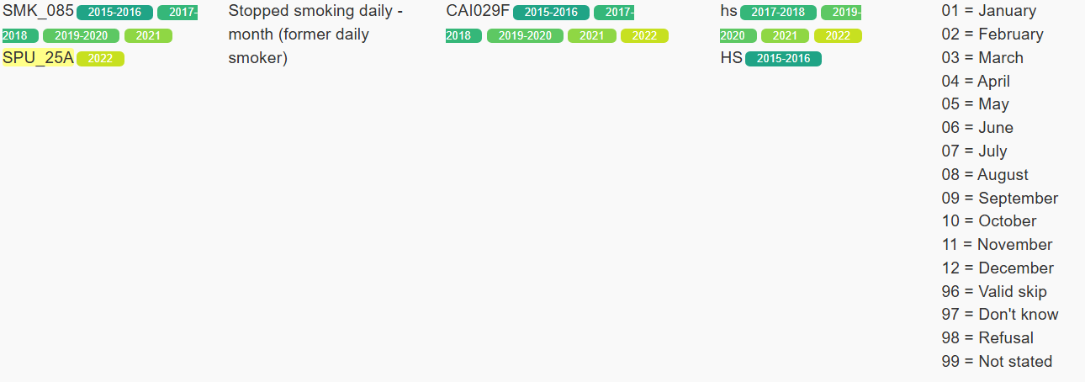
SMK_09A_cont
Can we use ADM_YOI, ADM_MOI, SPU_25A, and B to estimate the value for CCHS2022?
Notes:
ADM_YOI = year of interview
ADM_MOI = month of interview

